Slide 1
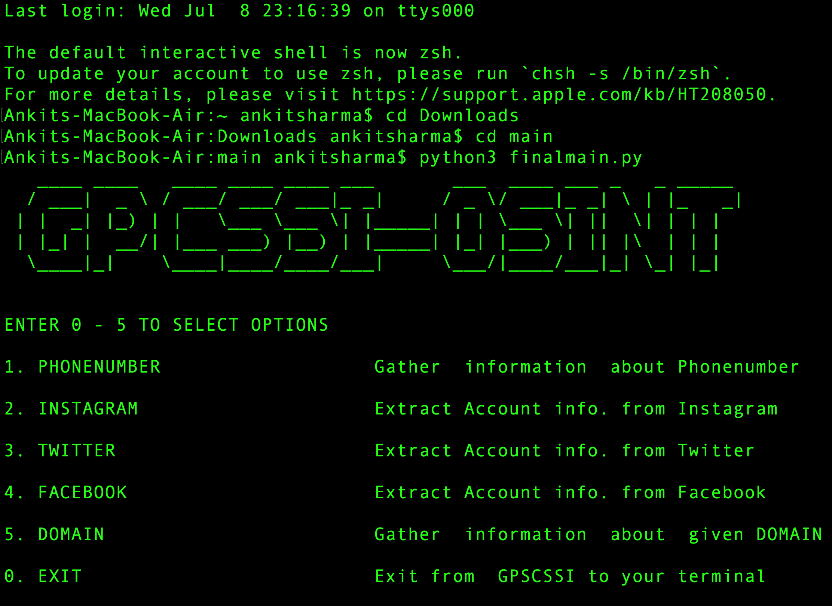
THE GPCSSI-OSINT TOOL
AN OPEN SOURCE SOCIAL ENGINEERING TOOL

Slide 2

INTRODUCTION
Open Source Intelligence refers to any information that can be legally gathered from free public sources
The use of Open Source Tools in Cybersecurity has become increasingly critical to gather information about the victim and the offender involved as these tools are time saving which is crucial to an investigation

Slide 3
GPCSSI-OSINT
The GPCSSI-OSINT is an integrated command line tool that is designed to perform advanced information gathering processes
Its aim is to attain maximum open source information from a Phone Number, Domain, Facebook/Twitter/Instagram username using modules available in Python such as requests, Beautiful Soup

Slide 4
OBJECTIVE OF THE TOOL
The world is witnessing a growing trend in the criminal activity including but not limited to identity theft, money scams, information stealing
With this in mind, an effective OSINT tool can be critical in investigations as they are time efficient and can reveal a lot of information from just a username or phone number
The GPCSSI-OSINT aims to provide maximum open source information about a Phone Number/Social Media username using an API Framework along with several Python modules available for information gathering

Slide 5
FEATURES OF THE TOOL
The GPCSSI-OSINT works on an API Framework. An API is a software that allows interaction between two applications to facilitate data exchange from one to the other. An API call is performed by using an API Key to gain access
The tool makes use of the modules like requests, json, Beautiful Soup for the information gathering process

Slide 6
IMPLEMENTATION
The tool can be used in a Linux, Windows and Mac environments and is operated by running the following commands from the command line:
pip3 install –r requirements.txt //installs all the module required
python3 finalmain.py //the tool is executed

Slide 7


Slide 8
MODULES

Slide 9
PHONE NUMBER
This module will perform an advanced scan on a phone number and provides the Country, Area, Line type and Carrier associated with the phone number
The tool accepts the phone number in the following format only : “+93 xxx-xxx-xxxx” where 93 represents the country code and prints an error if the number isn’t in the above format

Slide 10
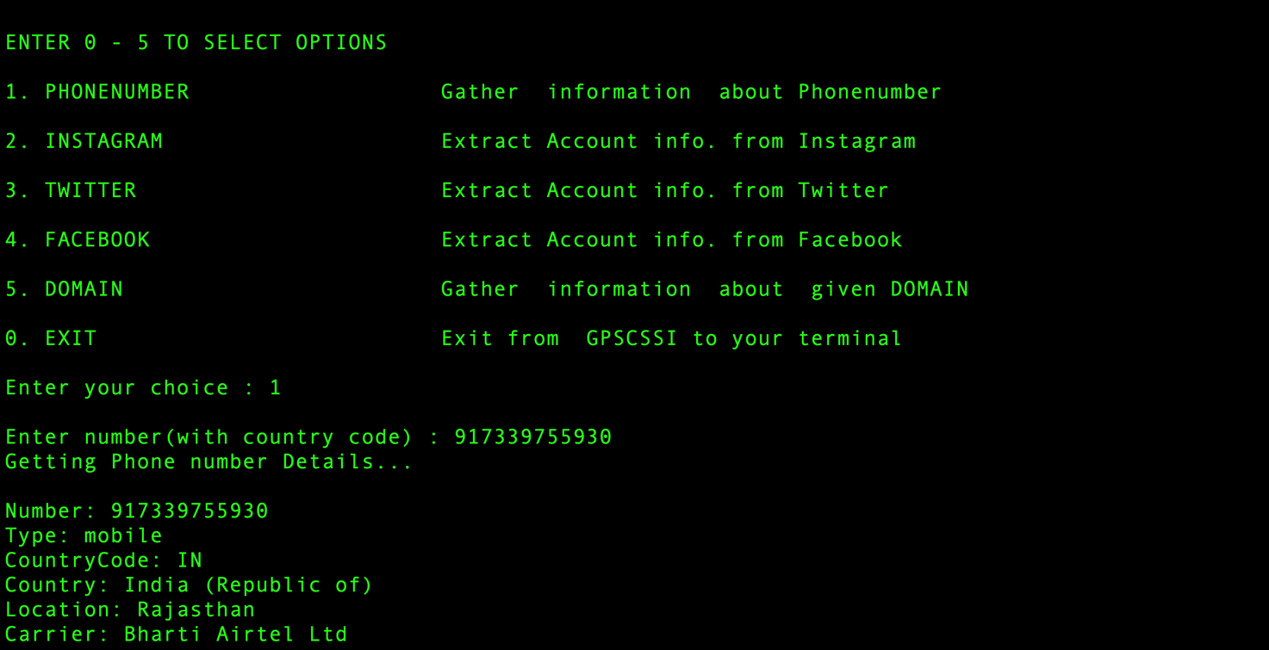

Slide 11
INSTAGRAM
The tool extracts information associated with an account of an inputted username which includes the Profile name, URL, followers and following, number of posts, bio, whether the account is verified or not
In addition to the API framework, the Instagram modules makes use of the Beautiful Soup module to extract specific information from the HTML source code of the account webpage
It makes use of the json module to format and consolidate the information which is then printed on the output terminal.

Slide 12
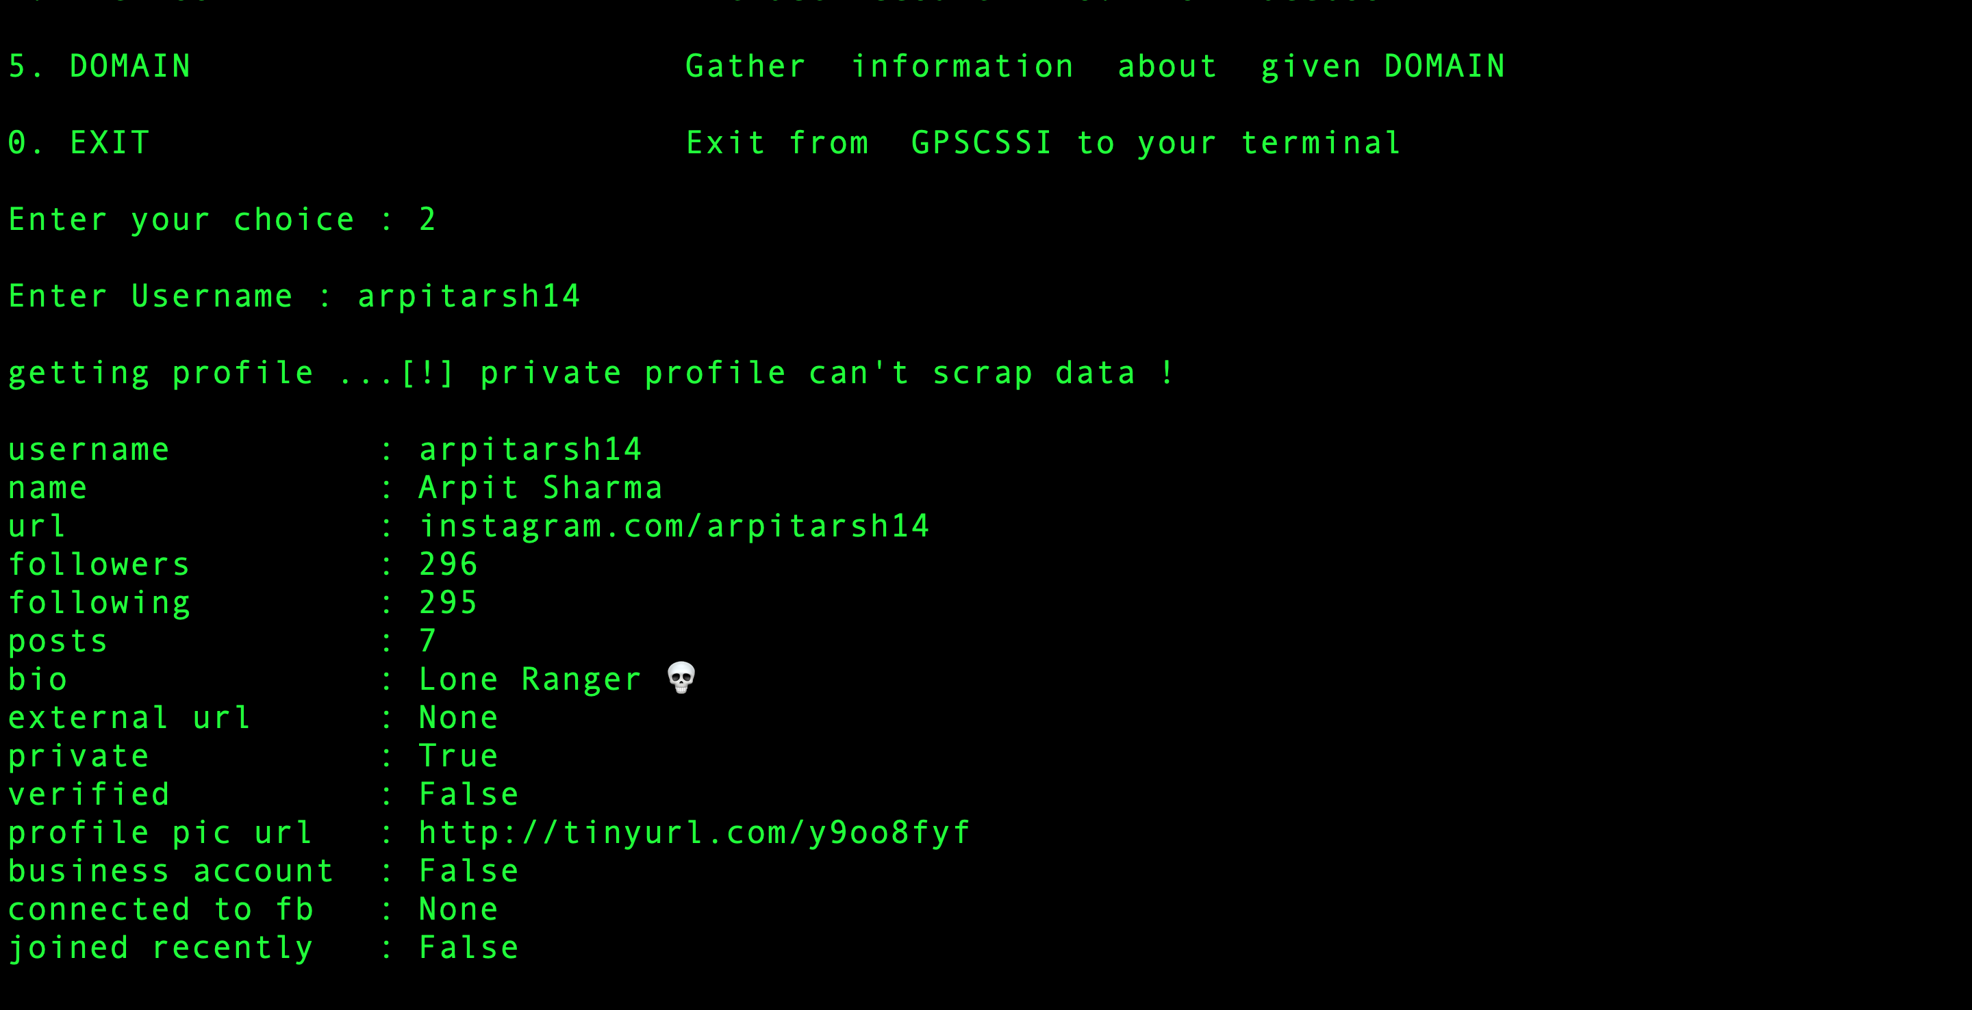

Slide 13
TWITTER
The Twitter module makes use of the Tweepy Module which allows us to access the Twitter API using a python code
This attributes of this module are used for the extraction of tweets from the Twitter accounts and the module then creates three file: a username.txt file which stores the profile information, a username.csv file which stores the text tweets and a username.jpg file to store the media files in the tweets.
The module makes use of pandas, and NumPy for formatting the data before writing it to the respective file

Slide 14
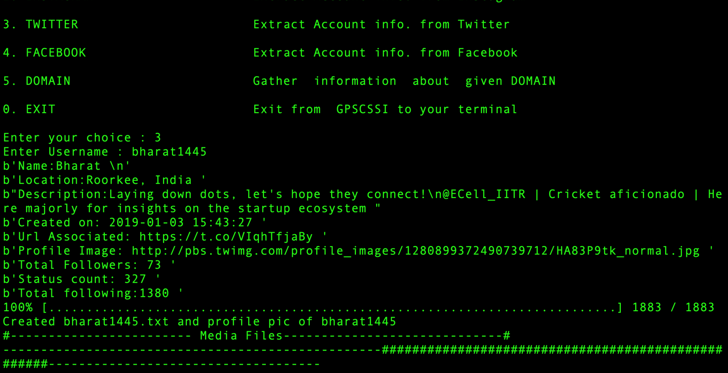

Slide 15
FACEBOOK
The Facebook module of the tool makes use of the bs4/Beautiful Soup Python library to parse the HTML source code of the Facebook webpage of the particular user whose username was entered.

Slide 16
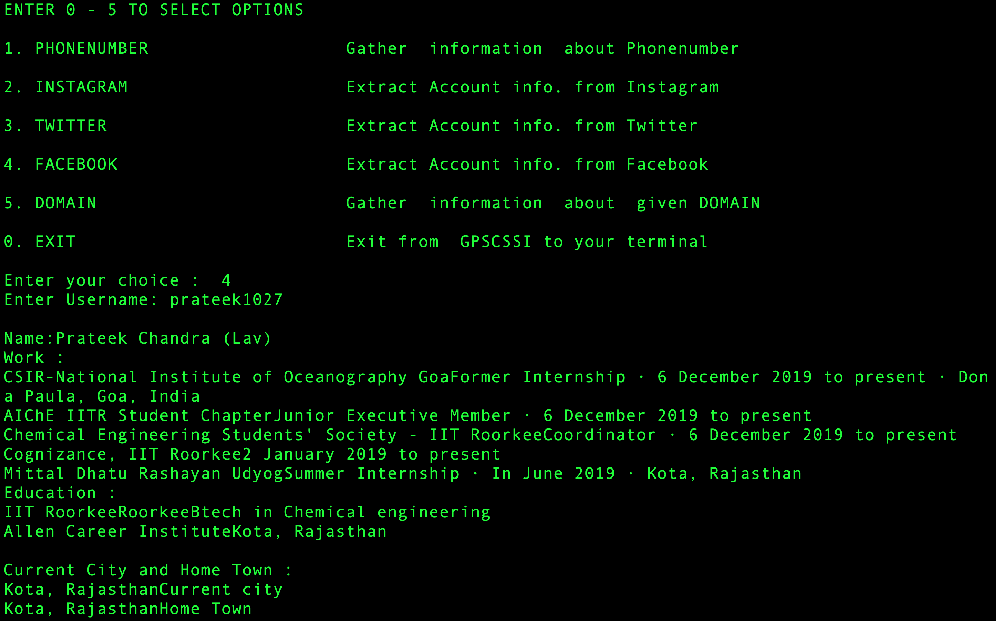

Slide 17
DOMAIN
It accepts the input in the format of “@” or “.com” (which is controlled by the use of an if-else function). If the input is in any other format it will print an error message showing ‘Invalid Email Address’.
The Domain module performs various scans for domain check for vulnerability and spider crawlers and fetches information about the mainly the email ID, first/last name and Twitter, Facebook, LinkedIn profile associated with a domain name

Slide 18
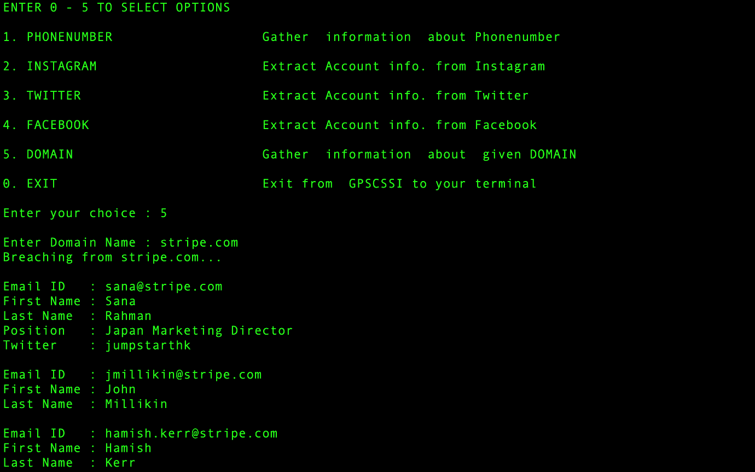

Slide 19
THANK YOU

